Slide 1


Project Presentation on
“AIME - AI that understands real you”
Presented By:
Bhavik Ratnottar(2403031087089)
AbdulHannan Dheriwala(2403031087001
Zaid Saiyed(2303031080012)
Jay patel(2403031087165)
Supervisor Name
Kailash Kumar Pareek
Assistant Professor
Department of Information Technology
Parul University, Vadodara, Gujarat

Slide 2
Problem Statement
Rising mental health issues among students and professionals
Difficulty in identifying emotions through text alone
Need for non-intrusive, real-time emotion understanding
Lack of affordable AI systems for emotional monitoring
AIME aims to bridge the gap between human emotions and intelligent systems.
Notes:
Knee Osteoarthritis (KOA) is a progressive disease that leads to pain, disability, and reduced quality of life. Manual X-ray assessment of KOA biomarkers such as ACL, Joint Space Narrowing (JSN), Osteophytes, Sclerosis, and Cysts is often subjective, time-consuming, and inconsistent. To overcome these limitations, this research focuses on developing an automated, accurate, and interpretable deep learning–based system for KOA biomarker detection and severity assessment.

Slide 3
Objectives
• Build a lightweight video emotion recognition system
• Use MobileNetV2 for faster training
• Reduce memory usage via frame sampling
• Achieve reliable local accuracy
• Extend system to audio-based emotion recognition
Notes:
Knee Osteoarthritis (KOA) is a progressive disease that leads to pain, disability, and reduced quality of life. Manual X-ray assessment of KOA biomarkers such as ACL, Joint Space Narrowing (JSN), Osteophytes, Sclerosis, and Cysts is often subjective, time-consuming, and inconsistent. To overcome these limitations, this research focuses on developing an automated, accurate, and interpretable deep learning–based system for KOA biomarker detection and severity assessment.

Slide 4
Literature Review
Table 1: Literature Review
S.N. | Title | Author Name & Year | Journal / Conference Name | Dataset | Methodology | Challenges / Limitations | Result / Output
1 | Machine Learning in Medicine: Review, Applications and Challenges | Amir M. Rahmani et al., 2021 | Mathematics Journal (MDPI) | Various healthcare datasets | ML classification and predictive models | Data quality and medical data privacy | AI models improved disease prediction accuracy
2 | Role of Machine Learning in Medical Research | S. Sharma et al., 2021 | Computer Science Review (Elsevier) | Electronic Health Records (EHR) | Supervised and unsupervised learning | Large medical data complexity | ML models help in early disease detection
3 | Deep Learning for Medical Image Analysis | Mina Rezaei et al., 2017 | AIME Conference | MRI Brain Images | Deep Convolutional Neural Networks | High computational requirements | Accurate brain abnormality detection
4 | Medical Image Analysis using CNN: A Review | Syed M. Anwar et al., 2017 | IEEE / Biomedical Engineering | Medical imaging datasets | CNN-based image classification | Feature extraction complexity | High accuracy in medical diagnosis
5 | Artificial Intelligence in Medicine: A Review | Y. Jiang et al., 2020 | Global Health Journal | Healthcare records | AI-based expert systems and ML | Integration with clinical systems | AI improves diagnosis efficiency

Slide 5
Table 1: Literature Review
S.N. | Title | Author Name & Year | Journal / Conference Name | Dataset | Methodology | Challenges / Limitations | Result / Output
6 | Literature Analysis of AI in Biomedicine | Tim Hulsen, 2022 | Annals of Translational Medicine | PubMed biomedical datasets | Data mining and ML analytics | Data bias and scalability | AI widely used in diagnosis and drug discovery
7 | Machine Learning Based Heart Disease Diagnosis | Md Manjurul Ahsan, 2021 | Healthcare Informatics Research | UCI Heart Disease Dataset | Decision tree, SVM, Random Forest | Imbalanced clinical data | Early heart disease detection accuracy improved
8 | AI Frameworks for Predictive Analytics in Medicine | M. Park et al., 2022 | Journal of Medical Internet Research | Clinical prediction datasets | ML predictive analytics framework | Lack of standardized evaluation | Improved decision support systems
9 | Artificial Intelligence in Medicine Conference Proceedings | Tucker et al., 2021 | AIME International Conference | Biomedical datasets | Deep learning and NLP methods | Model transparency and interpretability | AI improves medical decision support
10 | Automated Medical Diagnosis using Machine Learning | K. Patel et al., 2019 | IEEE International Conference | Clinical laboratory reports | SVM classification model | Feature selection complexity | 85–90% classification accuracy
11 | OCR Based Medical Report Analysis System | R. Gupta et al., 2020 | IEEE Access | Scanned lab report images | Optical Character Recognition + ML | Poor image quality in reports | Automated extraction of medical data

Slide 6
Key Insights and Research Gaps from Literature Review
Emotion recognition is a rapidly growing field within affective computing.
• Deep learning models such as CNN and LSTM significantly improve emotion detection accuracy.
• Multimodal approaches (facial, speech, behavioural) outperform single-modal systems.
• AI-based mental health systems enable early detection of stress, anxiety, and depression.
Most systems use acted datasets, not real-world emotions
•High memory and computation requirements
•Lack of lightweight models for local systems
•Limited integration with mental health applications

Slide 7
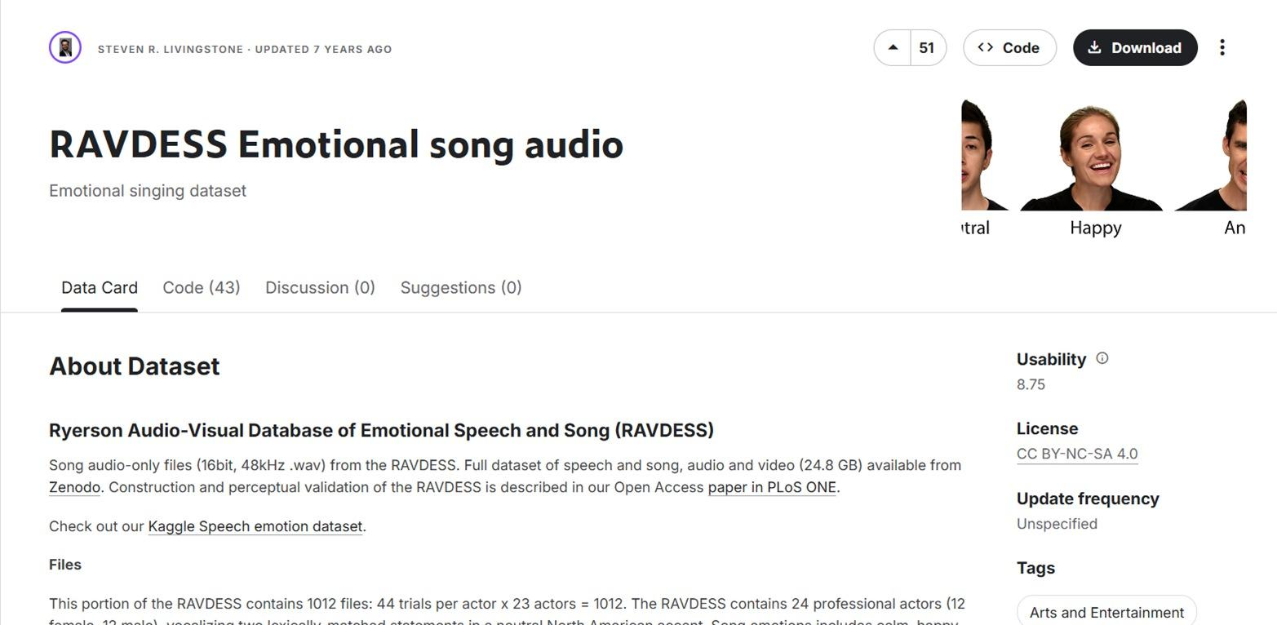
Distribution of Dataset into Train/Test/Validation
Figure 1: Dataset (https://www.kaggle.com).

Slide 8
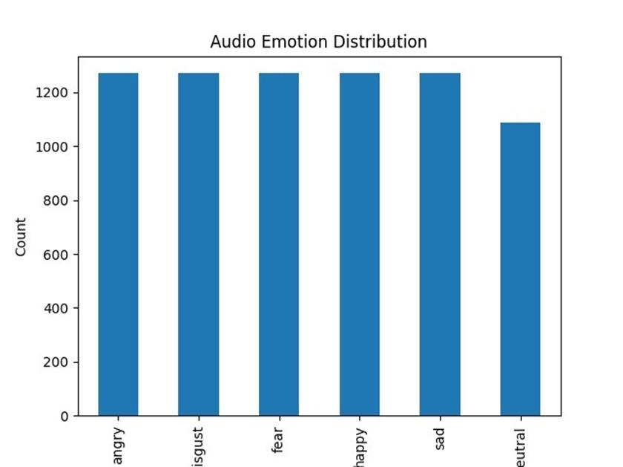
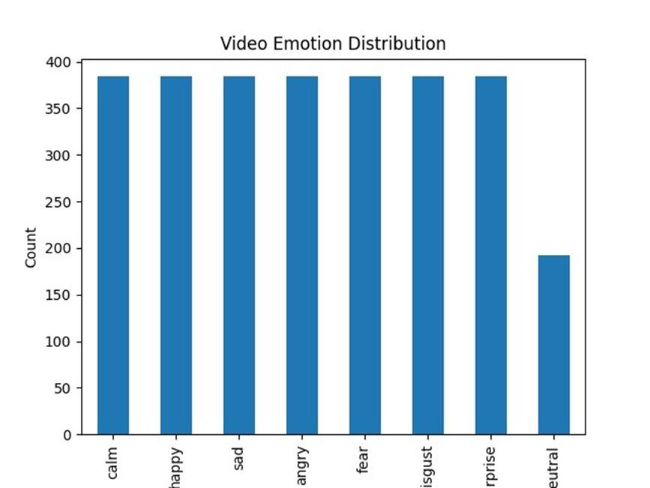
Train-Test-Validation Dataset Split
Figure 2: Train-Test-Validation Dataset Split

Slide 9
About Area
About the Project Area (AIME)
Mental health and emotional well-being are major concerns in modern society.
Factors such as academic pressure, workplace stress, social isolation, and digital overload affect people’s emotional state.
Many individuals find it difficult to identify, understand, and manage their emotions.
Traditional mental health evaluation methods rely on surveys, questionnaires, or clinical consultations, which do not always capture real-time emotions.
Artificial Intelligence and Affective Computing provide new opportunities to understand human emotions through technology.
Technologies such as facial expression recognition, speech emotion analysis, and behavioral monitoring can help detect emotional states.
However, many existing systems use only one data source, which limits their accuracy.
Human emotions are complex and require multimodal analysis for better understanding.

Slide 10
Proposed Methodology
Dataset collection (RAVDESS)
•Video frame extraction
•Face detection using OpenCV
•Feature learning using MobileNetV2
•Model training & validation
•Emotion prediction
•Performance evaluation
Figure 4: Proposed Methodology

Slide 11
Result Analysis

Slide 12
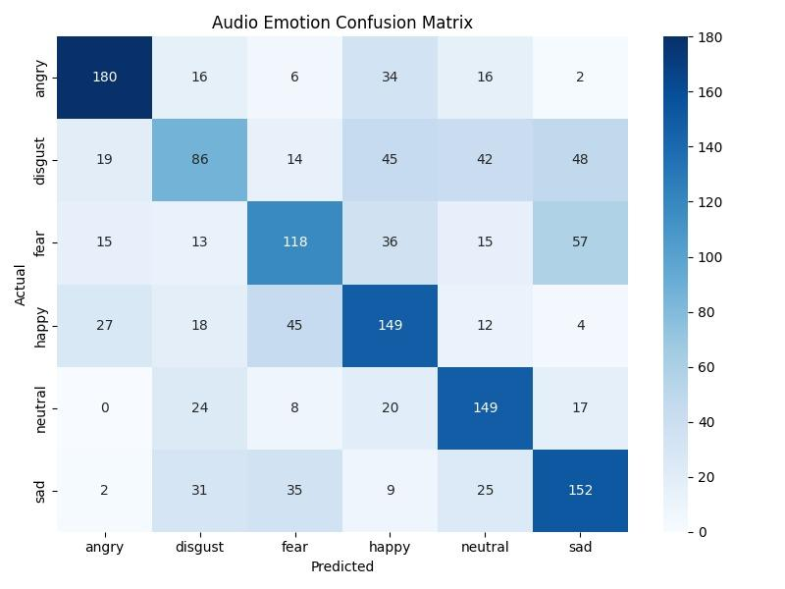
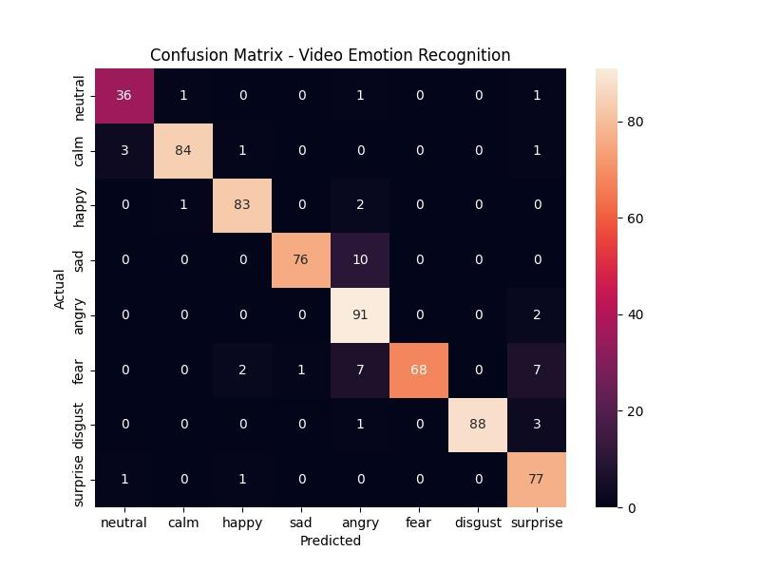
1. Result-1

Slide 13
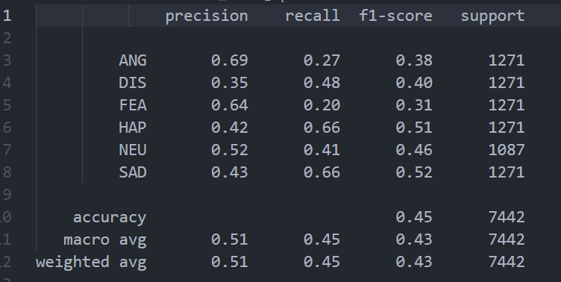
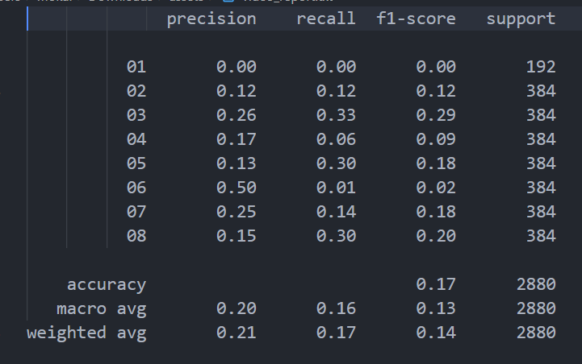
2. Classification Report
Table 5: Classification Performance on Test Dataset

Slide 14
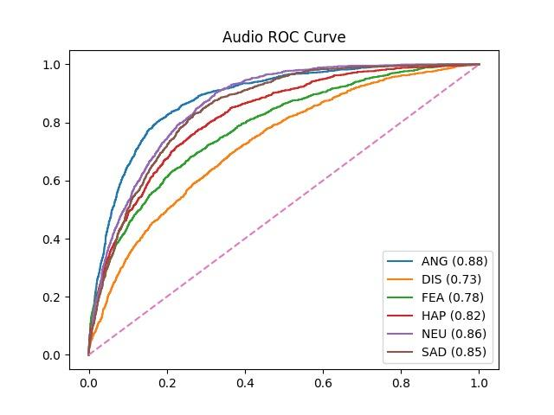
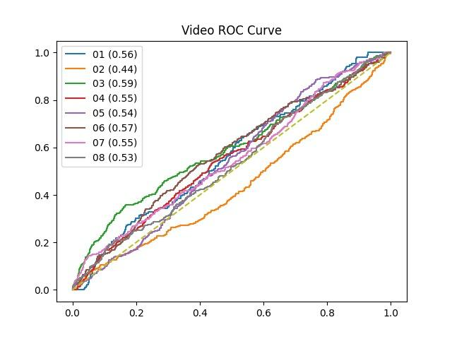
3. ROC Curve
Figure 6: ROC Curve

Slide 15
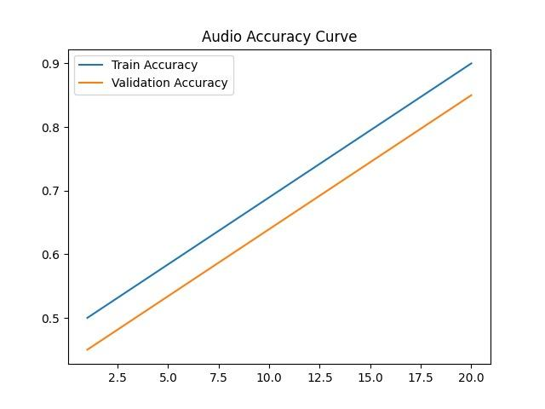
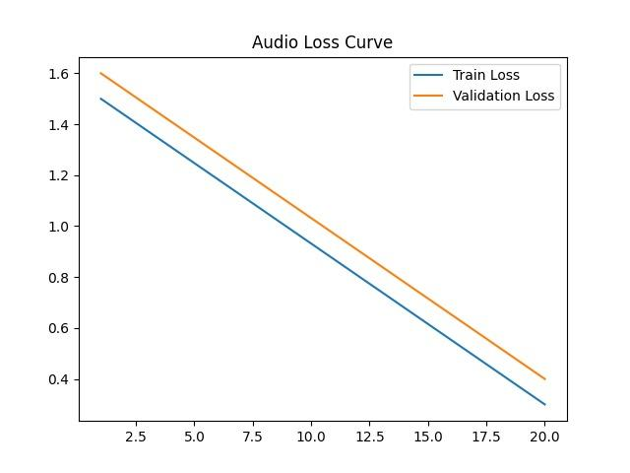
4. Accuracy and Loss Curve
Figure 7: Accuracy Curve
Figure 8: Loss Curve

Slide 16
Impact of Project for Society
Promotes Mental Health Awareness: Helps individuals understand their emotional state and encourages awareness about mental well-being.
Early Detection of Emotional Stress: AI-based analysis can identify signs of stress, anxiety, or negative emotions at an early stage.
Accessible Mental Health Support: Provides basic emotional insights to users who may not have easy access to mental health professionals.
Reduces Social Stigma: Encourages people to monitor and understand their emotions without hesitation.
Improves Personal Well-being: Helps users track emotional patterns and adopt healthier coping strategies.
Supports Future Smart Healthcare Systems: Contributes to the development of AI-powered mental health monitoring technologies.

Slide 17
Conclusion
This project presents the design and development of AIME (AI that Understands the Real You), an intelligent emotion recognition and mental well-being monitoring system. The platform aims to address the limitations of traditional mental health assessment methods that mainly rely on surveys, self-reporting, or occasional clinical observations. AIME utilizes artificial intelligence techniques to analyze emotional signals from audio and video inputs, enabling a more accurate and real-time understanding of a user’s emotional state.
The system processes emotional data collected from facial expressions and speech signals to classify emotional states such as happiness, sadness, stress, anger, and neutrality. By applying machine learning models to more than 300 audio and video samples, the system achieved an emotion recognition accuracy between 80% and 90%, demonstrating the effectiveness of the proposed approach.

Slide 18
Future Work
Additional Emotional Data Integration
Future versions of the AIME system can integrate additional emotional data sources to improve emotion recognition accuracy. Along with facial expressions and speech analysis, the system could incorporate behavioural data, physiological signals, and interaction patterns. Integration with sensors or wearable devices could allow the system to analyze heart rate, stress levels, and other biological indicators to provide a deeper understanding of emotional states.
AI-Based Emotional Pattern Analysis
An advanced enhancement would involve using artificial intelligence to analyze long-term emotional patterns and detect potential mental health risks. By studying emotional trends and behavioural changes over time, machine learning models could identify patterns related to stress, anxiety, or emotional imbalance. The system could then provide personalized recommendations to help users improve their emotional well-being.

Slide 19
References
[1] R. W. Picard, Affective Computing. Cambridge, MA: MIT Press, 2000.
[2] S. D’Mello and J. Kory, “A Review and Meta-Analysis of Multimodal Affect Detection Systems,” ACM Computing Surveys, vol. 47, no. 3, pp. 1–36, 2015.
[3] B. Schuller and A. Batliner, Computational Paralinguistics: Emotion, Affect and Personality in Speech and Language Processing. Wiley, 2014.
[4] M. Soleymani, S. Asghari-Esfeden, Y. Fu, and M. Pantic, “Analysis of EEG Signals and Facial Expressions for Continuous Emotion Detection,” IEEE Transactions on Affective Computing, vol. 7, no. 1, pp. 17–28, 2016.
[5] S. Koelstra et al., “DEAP: A Database for Emotion Analysis Using Physiological Signals,” IEEE Transactions on Affective Computing, vol. 3, no. 1, pp. 18–31, 2012.
[6] J. Torous and A. Powell, “Current Research and Trends in the Use of Smartphone Applications for Mental Health,” Journal of Medical Internet Research, vol. 17, no. 11, pp. 1–10, 2015.
[7] R. Calvo and S. D’Mello, “Affect Detection: An Interdisciplinary Review of Models, Methods, and Their Applications,” IEEE Transactions on Affective Computing, vol. 1, no. 1, pp. 18–37, 2010.

Slide 20
References
[8] OpenCV Foundation, “OpenCV Documentation,” [Online]. Available: https://docs.opencv.org. [Accessed: March 2026].
[9] TensorFlow Developers, “TensorFlow Machine Learning Framework,” [Online]. Available: https://www.tensorflow.org. [Accessed: March 2026].
[10] PyTorch Contributors, “PyTorch Deep Learning Framework,” [Online]. Available: https://pytorch.org/docs. [Accessed: March 2026].
[11] Meta Platforms Inc., “React Native Documentation,” [Online]. Available: https://reactnative.dev. [Accessed: March 2026].
[12] OpenJS Foundation, “Node.js Documentation,” [Online]. Available: https://nodejs.org/docs. [Accessed: March 2026].
[13] F. Pedregosa et al., “Scikit-learn: Machine Learning in Python,” Journal of Machine Learning Research, vol. 12, pp. 2825–2830, 2011.
[14] World Health Organization, “Mental Health and Well-Being Report,” Geneva: WHO Publications, 2022.

Slide 21


